Slide 1
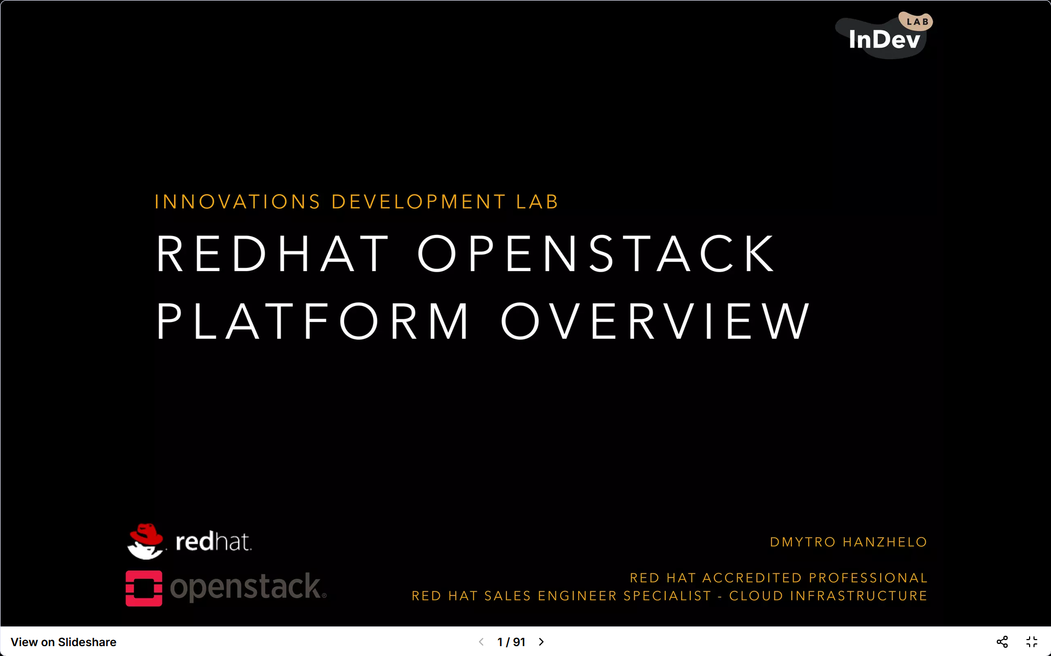
INTRODUCTION

Slide 2
What is OpenStack ?
Fully opensource cloud “operating system”
Comprised of several open source sub-projects
Provides all of the building blocks to create an Infrastructure-as-a-Service cloud
Designed and architected to replicate public cloud infrastructure, e.g. Amazon AWS
Governed by the vendor agnostic OpenStack Foundation
Enormous market momentum with signiﬁcant investment from major players

Slide 3
Why does the world need OpenStack ?
Cloud is widely seen as the next-generation IT delivery model
  Agile & Flexible
  Utility-based on-demand consumption
  Self-service driving down administrative overhead and maintenance
Public clouds are setting the benchmark of how IT could be delivered to users
  - Not all organisations are ready for public cloud

Slide 4
Why does the world need OpenStack ?
Applications are being written differently today
  More tolerant of failure
  Making use of scale-out architecture Why does the world need OpenStack?

Slide 5
Traditional Workload vs
Cloud-enabled Workload

Slide 6
Traditional Workload
Our data is too large
  Volumes of data are being generated at unprecedented levels
  Most of this data is unstructured
Service requests are too large
  More and more devices are coming online
  Tablets, phones, laptops, BYOD generation
Crucially, applications weren’t written to cope with the demand!
  - Traditional infrastructure capabilities are being exhausted • Service uptime, QoS, KPI’s and SLA’s are slipping

Slide 7
Traditional Workload
Crucially, applications weren’t written to cope with the demand!
  Traditional infrastructure capabilities are being exhausted
  Service uptime, QoS, KPI’s and SLA’s are slipping

Slide 8
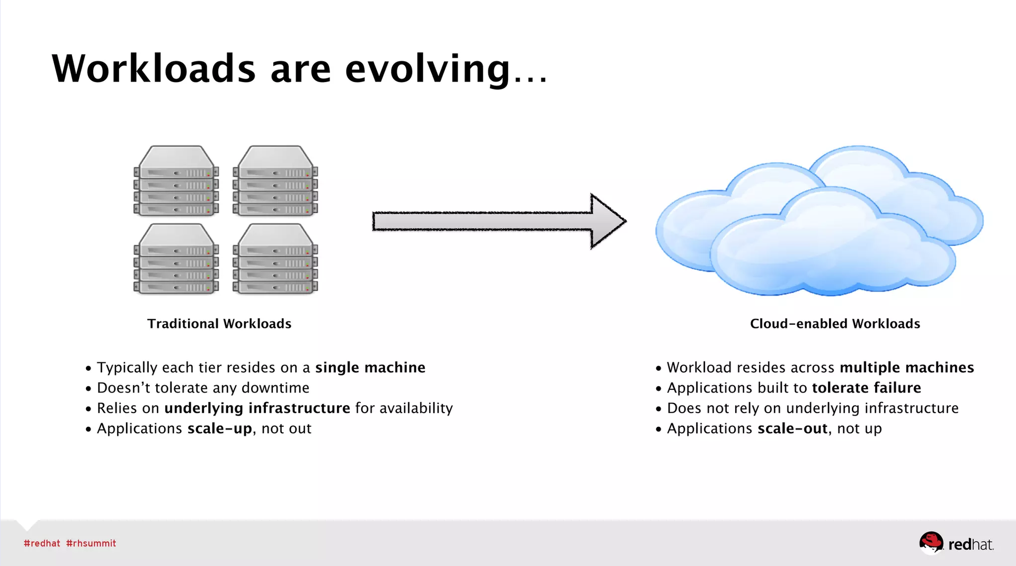

Slide 9
How does OpenStack fit in ?
A public cloud-like Infrastructure-as-a-Service cloud platform
  Internal “Infrastructure on Demand” - private cloud
  Test and Development environments - e.g. sandbox
  Cloud service provider platform - reselling compute, network & storage
Building a scale-out platform for cloud-enabled workloads
  Netﬂix(-like) applications
  Academic or pharma workloads, e.g. genetic sequencing

